Slide 1
Today’s Agenda
Merge Sort (Divide and Conquer)
  Design issues
  Complexity Analysis
Merge Sort Vs Insertion Sort
Minor CSE: Data Structures

Slide 2
Merge Sort
  Divide: Divide the n_element sequence to be sorted into two subsequences of n/2 elements each.
  Conquer: Sort the two subsequences recursively using merge sort.
  Combine: Merge the two sorted subsequences to produce a sorted list.
  The general algorithm for the merge sort is as follows:
  If the list is of size greater than 1, then
    Find the mid-position of the list.
    Merge sort the first sublist.
    Merge sort the second sublist.
    Merge the first sublist and the second sublist.
Minor CSE: Data Structures

Slide 3
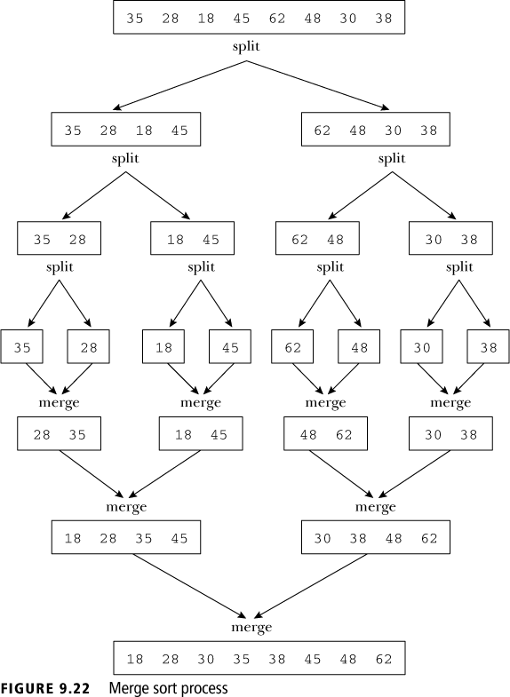
Minor CSE: Data Structures

Slide 4
Example:
3 | 6 | 5 | 7 | 2 | 1 | 10 | 8 | 9 | 4
1 | 2 | 3 | 4 | 5 | 6 | 7 | 8 | 9 | 10
3 | 6 | 5 | 7 | 2
2 | 3 | 5 | 6 | 7
1 | 10 | 8 | 9 | 4
1 | 4 | 8 | 9 | 10
3 | 6
3 | 6
5 | 7 | 2
2 | 5 | 7
1 | 10
1 | 10
8 | 9 | 4
4 | 8 | 9
3
3
6
6
5 | 7
5 | 7
2
2
1
1
10
10
8 | 9
8 | 9
4
4
5
5
7
7
8
8
9
9
Minor CSE: Data Structures

Slide 5
Merging
“merge” operation:
  Merge two ordered lists such that they result in a single ordered list (containing all elements from either list).
  Can we find a reduction / division to exploit this operation?
Minor CSE: Data Structures

Slide 6


Example
l
m
m+1
n
initList
4
5
7
11
2
3
6
8
14
i1
i1
i1
i1
i2
i1
i2
i2
i2
i2
i2
Copy the small one to mergeList
mergeList
2
3
4
5
6
7
8
11
14
iResult
iResult
iResult
iResult
iResult
iResult
iResult
iResult
iResult
iResult
iResult = l
Copy the rest to mergeList
Minor CSE: Data Structures

Slide 7
Merging two sorted Array
Once the sublists are sorted, the next step in the merge sort algorithm is to merge the sorted sublists. Suppose L₁ and L₂ are two sorted lists as follows:
  L₁: 2, 7, 16, 35
  L₂: 5, 20, 25, 40, 50
Merge L₁ and L₂ into a third list, say L₃. The merge process is as follows: repeatedly compare, using a loop, the elements of L₁ with the elements of L₂ and copy the smaller element into L₃.
Minor CSE: Data Structures

Slide 8
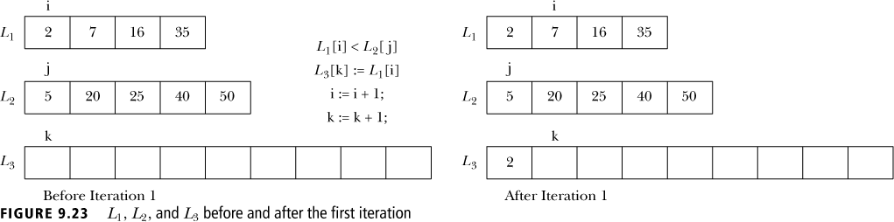
Example
First compare L₁[1] with L₂[1] and see that L₁[1] < L₂[1], so copy L₁[1] into L₃[1] (see Figure 9.23). (Notice that i, j , and k are set to 1.)
Minor CSE: Data Structures

Slide 9
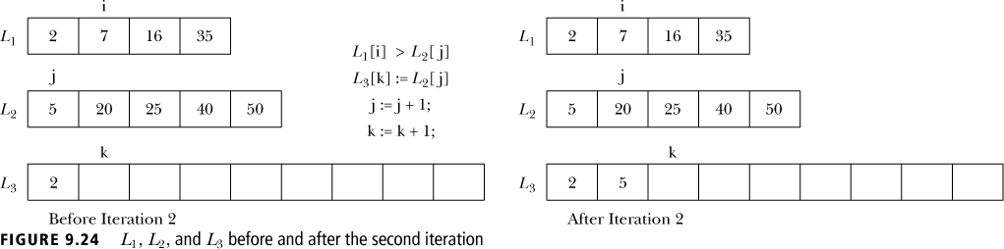
Example (Con’t)
After the first iteration, i = 2, j = 1, and k = 2. Next, compare L₁[2] with L₂[1] as shown in Figure 9.24.
Minor CSE: Data Structures

Slide 10

Example (Con’t)
After the second iteration, i = 2, j = 2, and k = 3. Next, compare L₁[2] with L₂[2] as shown in Figure 9.25.
Minor CSE: Data Structures

Slide 11

Example (Con’t)
After the third iteration, i = 3, j = 2, and k = 4. Next, compare L₁[3] with L₂[2] as shown in Figure 9.26.
Minor CSE: Data Structures

Slide 12

Example (Con’t)
After the fourth iteration, i = 4, j = 2, and k = 4. Next, compare L₁[4] with L₂[2] as shown in Figure 9.27.
After the fifth iteration, i = 4, j = 3, and k = 5. Continue this process until all elements of one list are copied into the third list. Copy the remaining elements of the list (that has elements left to be merged) into the merged list.
Minor CSE: Data Structures

Slide 13
Sorting – Top Down Design
Sort list: A[0] to A[N-1]
M
Sort list: A[0] to A[⎣N/2⎦]
Sort list: A[⎣N/2⎦+1] to A[N-1]
M
Sort list: A[0] to A[⎣N/4 ⎦]
Sort A[⎣N/4 ⎦ +1] to A[⎣N/2⎦]
M
…
Minor CSE: Data Structures

Slide 14
Merge Sorting – Top Down Design
How do we combine results?
  Order-preserving operation needed!
  Requirement: Combine two sorted lists to one sorted list of all elements from either list.
  Merge fits the bill.
When do we terminate (the division)?
  Singleton lists are sorted (trivially).
Minor CSE: Data Structures

Slide 15
Merge Sorting
Repeated merging of 2 sorted lists at a time to form a combined sorted list of elements.
Can we merge in-place?
  Not if we are using fixed position lists (i.e. arrays).
How much extra space needed?
  Merging two lists of size m and n requires m+n new space.
Minor CSE: Data Structures

Slide 16
Design Modules
void merge(List ls1, List ls2, List lsNew)
uses
void mergesort(List unsortedLs)
Minor CSE: Data Structures

Slide 17
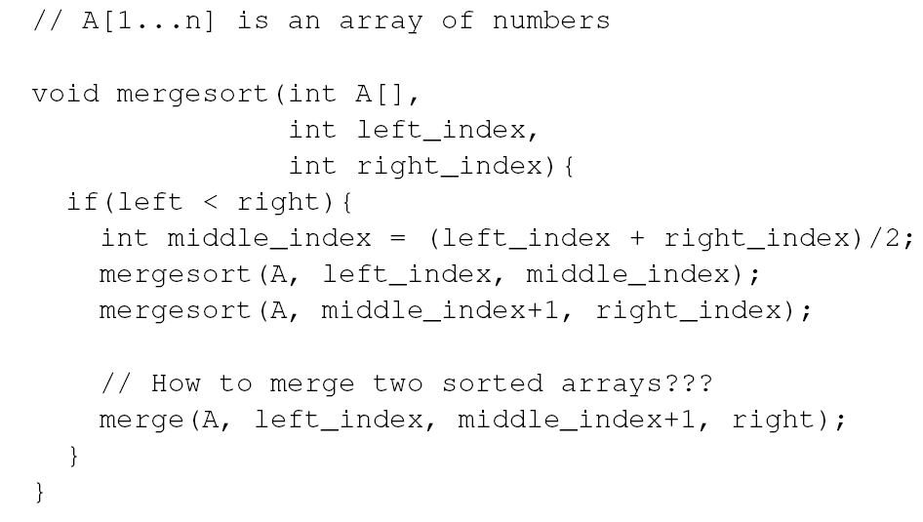
Merge Sort (Con’t)
Implementation (Divide):
Minor CSE: Data Structures

Slide 18
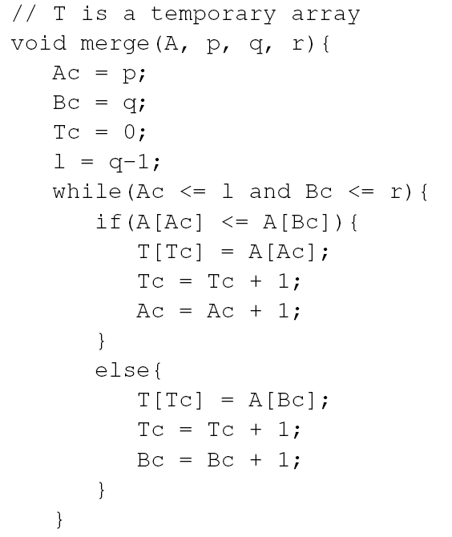
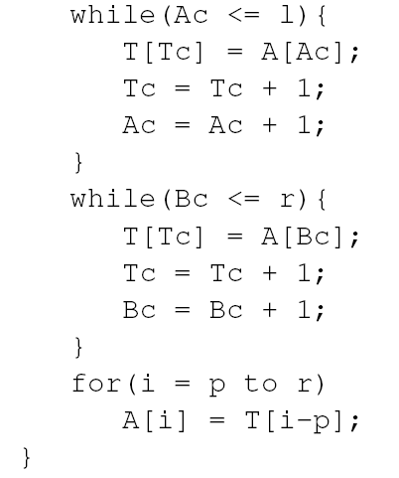
Merge Sort (Con’t)
Implementation (Merge):
Minor CSE: Data Structures

Slide 19
Merge Sort (Complexity)
Running time analysis:
  T(n): worst-case running time of merge sort to sort n numbers (assume n is a power of 2)
  Divide step: O(1) time
  Conquer step: 2T(n/2) time
  Combine step: O(n) time [at most n comparisons in each recursive step]
  Recurrence equation:
    T(1) = 1, if n=1
    T(n) = 2T(n/2) + n, if n>1
Minor CSE: Data Structures

Slide 20
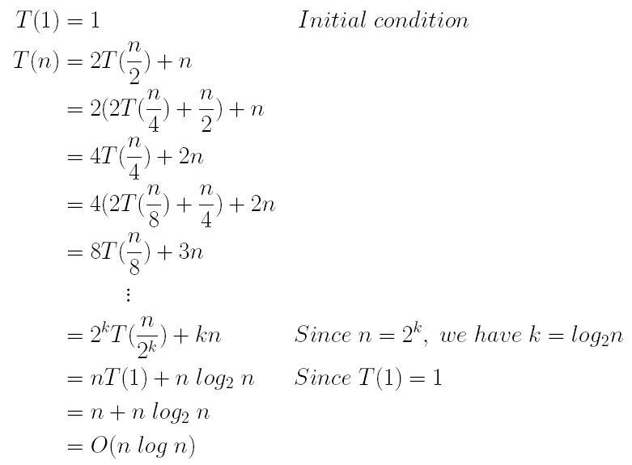
Merge Sort Complexity (Con’t)
Running time analysis (Con’t):
Minor CSE: Data Structures

Slide 21
Algorithm Merge Sort - Complexity
One series of merge operations for the list take O(N)
  N/2 pairs of 1 element lists
  N/4 pairs of 2 element lists
Outer loop executed O(logN) times
Total Time Complexity O(N*logN)
Total Space Complexity O(N)
Compare with InsertionSort:
  O(N²) time complexity and O(1) space complexity.
Minor CSE: Data Structures

Slide 22
Algorithm Merge Sort(Iterative)
for each j from 0 to ⎡N/2⎤ - 1
merge(ulist[2j to 2j], ulist[2j+1 to 2j+1])
for each j from 0 to ⎡N/4⎤ - 1
merge(ulist[4j to 4j+1], ulist[4j+2 to 4j+3]
…
// until only 1 pair of lists are left.
Minor CSE: Data Structures

Slide 23
Algorithm Merge Sort
k=1;
//while k <= ⎡N/2⎤ {
for each x from 0 to ⎡log N⎤ - 1 {
}
for each j from 0 to ⎡N/(2*k)⎤ - 1 {
start = 2 * k * j;
merge(ulist[start to start + k-1],
ulist[start +k to start+2k-1],
newList)
}
copy newList back into ulist
k = 2 * k; // double the size of lists
Minor CSE: Data Structures

Slide 24
void mergeSort(Member ms[], unsigned int size)
{
unsigned int i,j,x,start,k=1;
Member newList[100];
for(x=0;x<ceil((log(size))/(log(2)));x++)
{
for(j=0;j<=(ceil(((double)(size)/(double)(2*k))));j++)
{
start=2*k*j;
merge(ms,start,(start+k-1),(start+k),(start+(2*k)-1),newList);
}
for(j=0;j<size;j++)
{
ms[j]= newList[j];
printf("%d\t",newList[j]);
}
printf("\n");
k=k*2;
}
}
Minor CSE: Data Structures

Slide 25
Algorithm Merge Sort - Analysis
List size is doubled each iteration.
  Outer loop: x = 0,1, 2, … log(N)-1 leads to O(logN) iterations
  If N is not a power of 2, some of the lists may be empty.
  Problem to fix: Use N as the limit and rewrite inner loop.
  Contract: Merge accepts lists of different size including empty lists!
Minor CSE: Data Structures

Slide 26
Algorithm Merge Sort – Inner Loop
if (start < N) {
if (start + k > = N) {
e1 = (N – 1);
copy(ulist[start, e1], newList[start, e1]);
} else {
e2 = ((start + 2k-1) >= N) ? (N – 1) : (start + 2k – 1);
}
}
merge(ulist[start to e1], ulist[start +k to e2],
newList[start to start+e2]);
Minor CSE: Data Structures

Slide 27
start=2*k*j;
if(start<size)
{
if((start+k)>=size)
{
for(i=start;i<size;i++)
newList[i]=ms[i];
}
else
{
if((start+(2*k)-1)>=size)
merge(ms,start,(start+k-1),(start+k),(size-1),newList);
else
merge(ms,start,(start+k-1),(start+k),(start+(2*k)-1),newList);
}
}
Minor CSE: Data Structures

Slide 28
Merge Sort vs. Insertion Sort
Time vs. Space Tradeoff
Online vs Offline:
  Insertion does not need all elements at one to start sorting (Online Sorting)
Off-memory Sorting:
  Merge operation does not use random access – it selects elements one-by-one in left-to-right order.
  Sequential Access Lists:
    Files (Abstract)
    Disks, Tape (Concrete)
Minor CSE: Data Structures

Slide 29
END
Minor CSE: Data Structures

